Slide 1
Review Sentiment Prediction

Slide 2
PROBLEM STATEMENT
Binary classification problem where you need to predict whether the review sentiment is positive or negative
Target Variable : Netgain

Slide 3
01
Data Wrangling
Cleaning the raw data and making it useful for further analysis.
02
Data Exploration
Gaining insights from the data to find correlated features.
03
ML Model Implementation & Selection
Trying different ML models & selecting the best performing model.
04
Our
Approach
Implementation on Data
Understanding the Best Model to Implement on the Test Data

Slide 4
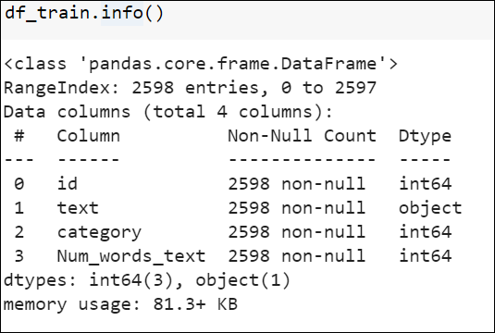
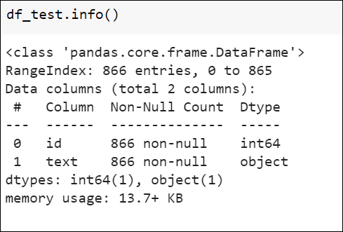
Structure of the Dataset
Test Data: (866, 2)
Training Data: (19536, 12)
No Missing Value Present in the Dataset

Slide 5
Attributes of the Dataset
id
Unique id for each tuple.
text
Tokenized text content of the review
category
The reviews have been categorized into two categories representing positive and negative reviews. 0 represents positive reviews and 1 represents negative reviews.

Slide 6
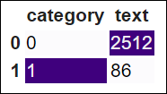
Exploratory Data Analysis
Category Text

Slide 7
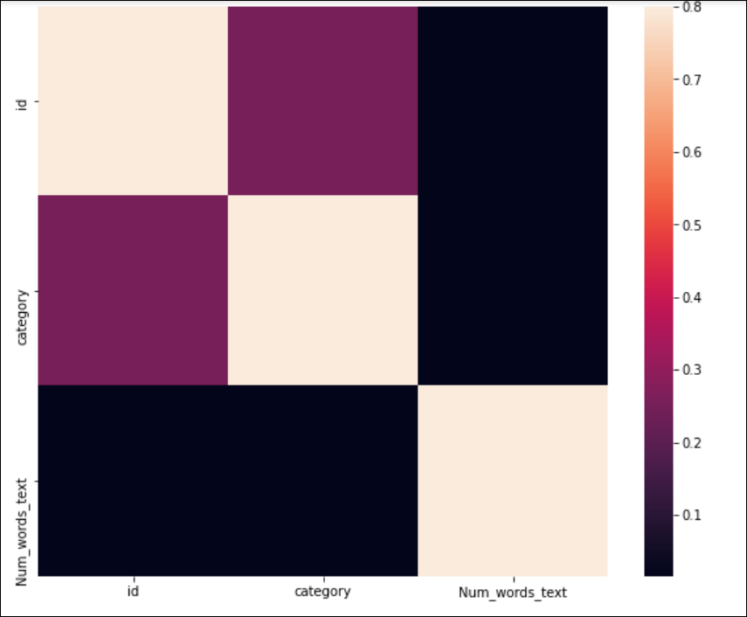
Exploratory Data Analysis
Correlation Matrix

Slide 8
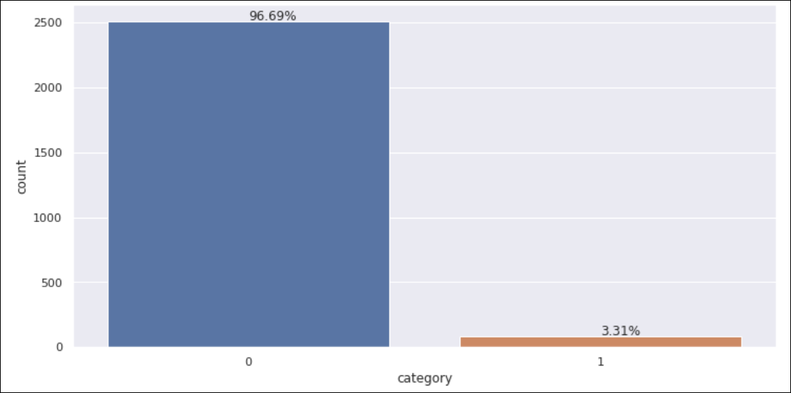
Exploratory Data Analysis
Around 96.69% and 3.3% of the positive reviews and negative reviews resp.
0- Positive Reviews
1- Negative Reviews

Slide 9
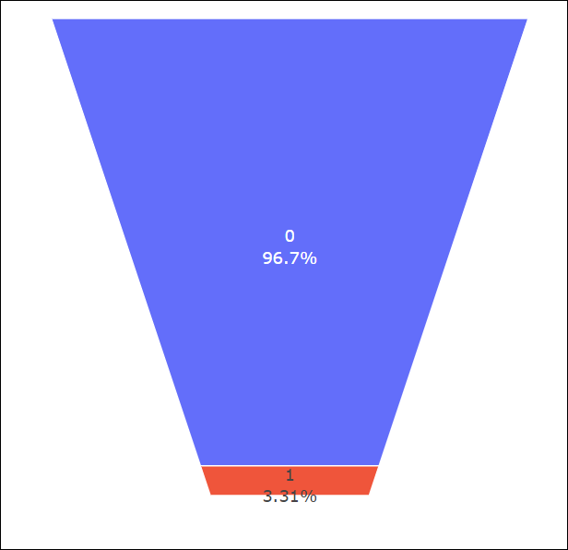
Exploratory Data Analysis

Slide 10
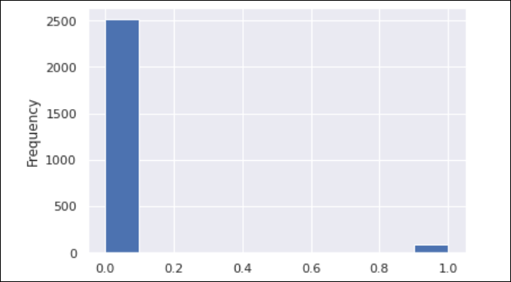
Exploratory Data Analysis

Slide 11
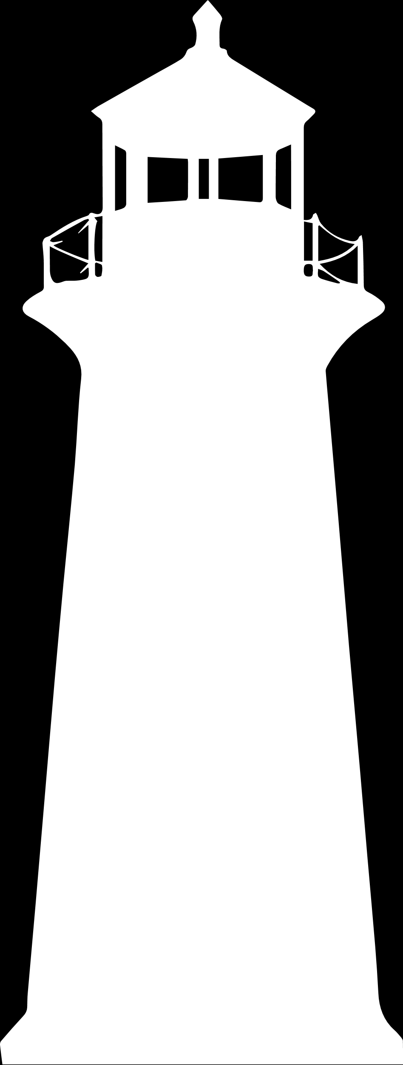
Approached Models and Evaluation Scores
Logistics Regression
Random Forest Regressor
01
03
02
SVM
04
Bagging Classifier
Precision: 0.1
Precision: 1.0
Precision: 0.2
Precision: 0.2

Slide 12
Model Selection
Random Forest Algorithm
Random forests or random decision forests are an ensemble learning method for classification, regression and other tasks that operate by constructing a multitude of decision trees at training time and outputting the class that is the mode of the classes (classification) or mean/average prediction (regression) of the individual trees.
Random Forest model is used to Predict the targeted variable on the test variable

